Slide 1

SPAS
Silent Public Address System
by
GASS
Gautam Ashrith Sushma Swapnik

Slide 2

Have you ever travelled by train ?
How did you get to know which platform your train would be on?
And how attentive were you while announcements were being made?
What about those times of unpredictable delay?

Slide 3
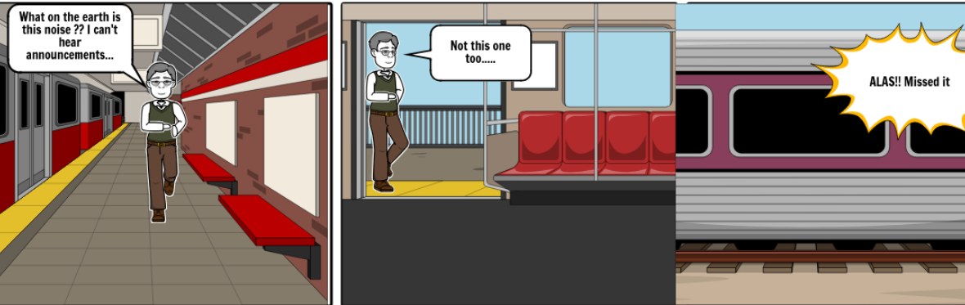
The Story Board

Slide 4
Public announcement system in indian railways
There is often a lot of noise in railway stations due to trains and general commotion, and sometimes technical defects
Announcements made in railway stations are not always audible as a result
Passengers are demanded to be attentive at all times
Such announcements through speakers and screens may not be of any help to the differently abled
Smartphones and the internet are not universal

Slide 5
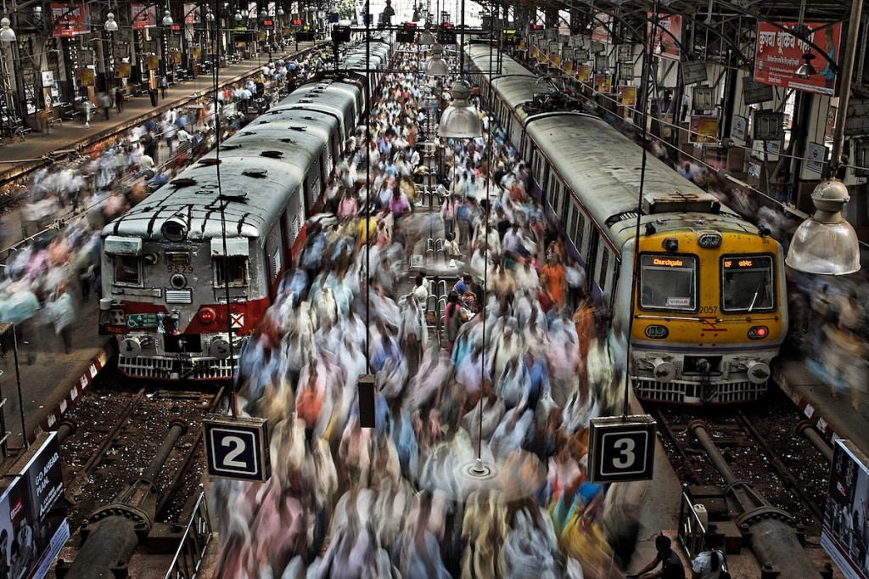
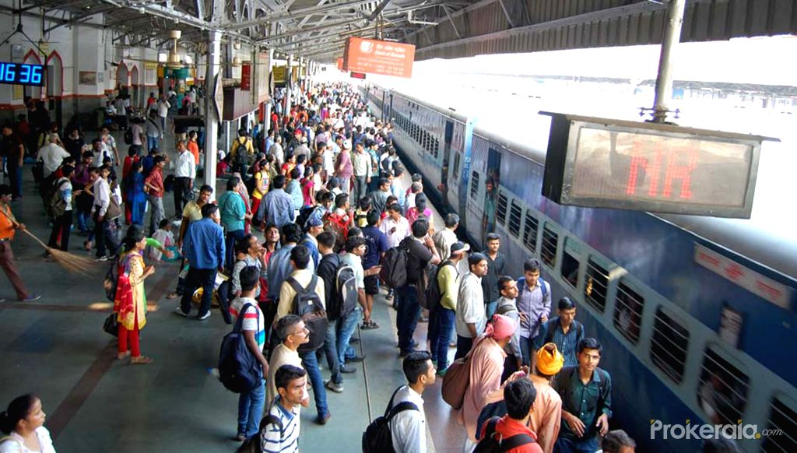

Slide 6

OuR Hack
To create a system that notifies
Personally, regularly
Without the need of internet
Even on a simple mobile
And is both readable and audible

Slide 7
IMPLEMENTATION
A device carrying app is present at various locations in the railway station
Users can feed in their mobile number and train number
SMS containing present status and a link is sent to the user whenever there is an update on the train status
Link contains live updates of the user's train
One can look for status of all other trains going through the station

Slide 8

FUTURE FEATURES
To have a QR code scanner instead of manual input at entrance
Eliminate the need for TC through digitization of ticket collection process using QR code scanners
Implementing notifications through automated phone calls

Slide 9

THANK YOU

